Slide 1
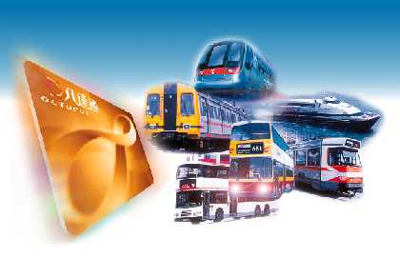
Hong Kong Octopus System
Technology applied in the use
of the Octopus Card
WY Lee
Development Manager
Creative Star Ltd

Slide 2
Contents
Brief History and Current Status
Card Technology
Applications
System Architecture
Future Plan and Conclusion

Slide 3
Timeline
First concepts – 1992
JV Shareholders agreement – 1994
Contract award to system integrator – 1994
Sony Card selected – 1995
Public launch – Sep 1997
Deposit taking company – 2000
6m daily transactions – Nov 2000

Slide 4







The Organization
Creative Star Limited – established in 1994
Service Providers
  New World First Bus New World First Ferry
  NW Telecom HKUST Bus
  HKTel Hongkong & Kowloon Ferry
  Kwoon Chung Bus Chung Tung Minibus
  New Lantau Bus HKR Airport Ferry
  Aberdeen Maxicab Star Ferry
  Swire CoCa Cola Maxim Fast Food
  7-Eleven Vitaland School Shops
  Wilson parking Starbucks

Slide 5
Current Status
More than 7 million cards + watches
Average daily transactions around 5.6 million
HK$40 million in transaction value per day
40+ Service Providers
Over 15,000 devices in the field
91% economically active population penetration

Slide 6
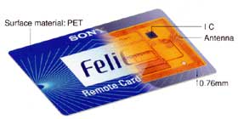
Card Technology
Sony Contactless Smart Card Technology
Radio Waves 13.56MHz
Communication Speed: 211Kbps
Memory: EPROM 16bytes x 96 blocks

Slide 7
Contactless Smart Cards - How they work
Application Specific IC
RISC
Radio
Transceiver
Memory
Antenna

Slide 8
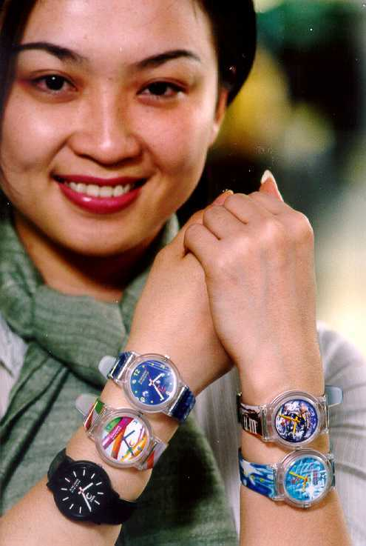
Octopus watch
Small antenna
Non-metallic case
Other wearables

Slide 9
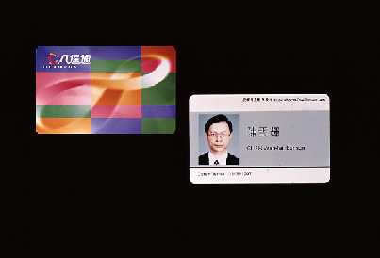
Personalized Octopus
Mandatory for Autopay
Used as Staff ID
Loyalty Schemes
Student Concessions
350,000 Issued
Different data stored in card to identify concession, staff, bonus points, autopay etc.

Slide 10
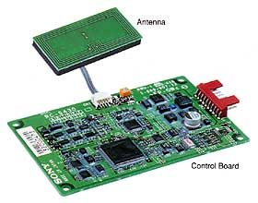
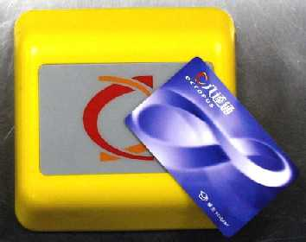
Contactless Smartcard Readers
Reader/Writer
Distance: 100mm / 20mm
Transaction time: < 300ms
CPU: 32bit with RAM and Flash
Interface: RS232C or RS485

Slide 11
Encryption
Fast symmetric encryption
  Same keys for encryption and decryption
Dynamic keys
Different keys for different areas
Mutual authentication (R/W and Card)
  RW sends K_{A}(R_{A}) and expects K_{B}(R_{A})
  Card sends K_{B}(R_{B}) and expects K_{A}(R_{B})
  Subsequent messages encrypted by R_{B}

Slide 12
Octopus Processor
Sony Reader/writer inside
Embedded microprocessor system
Tailored for the particular application
Gates
Bus unit
Platform unit
Enquiry unit
Office unit
Portable unit
Minibus unit
Vending machine unit
Retail unit
Access Control unit
Parking Meter
Add value machine

Slide 13
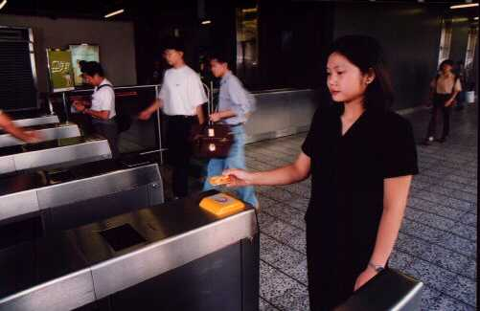
Passenger Gate
Controls also magnetic ticket and turnstile
Connected to station computer

Slide 14
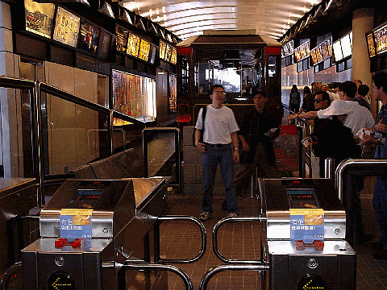
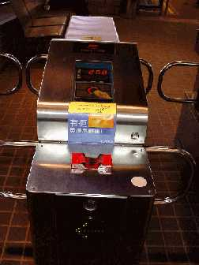
Peak Tram

Slide 15
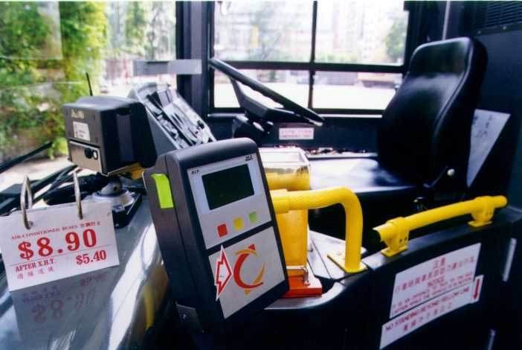
Buses
Driver control unit
Route selection
Sectional fare
Driver sign-on card
Wireless LAN connecting to Depot computer
Fare table/ config/ programs can be updated via wireless LAN

Slide 16
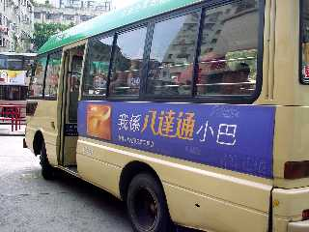
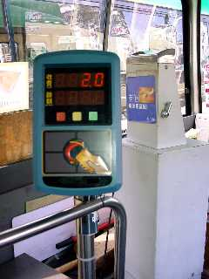
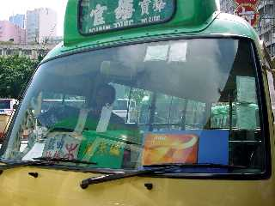
PLB Operations

Slide 17
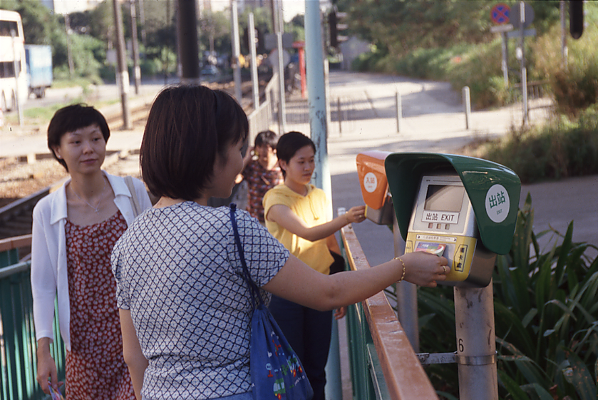
Light Rail
Platform processors acting as:
  Entry processor
  Exit processor
  Enquiry processor
Deduct highest fare on entry
Rebate difference on exit
Bonus point scheme

Slide 18
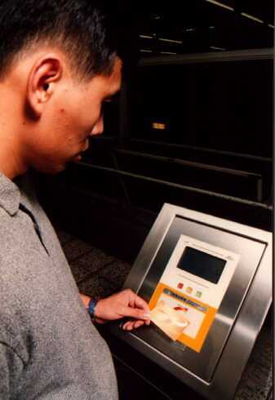
Enquiry Terminal
Details of last and up to 10 transactions
Multi-language Chinese/English

Slide 19
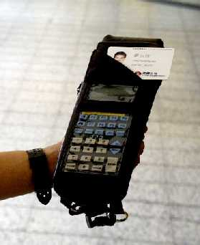
Portable Card Analyser (PCA)
Instant ticket inspection
Facility for printing violation receipt

Slide 20
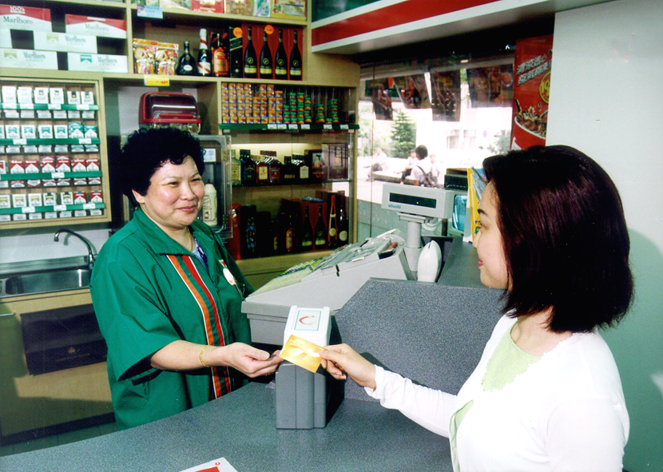
7-Eleven
Integrated with Point-of-Sale system
7-Eleven network connects all stores

Slide 21
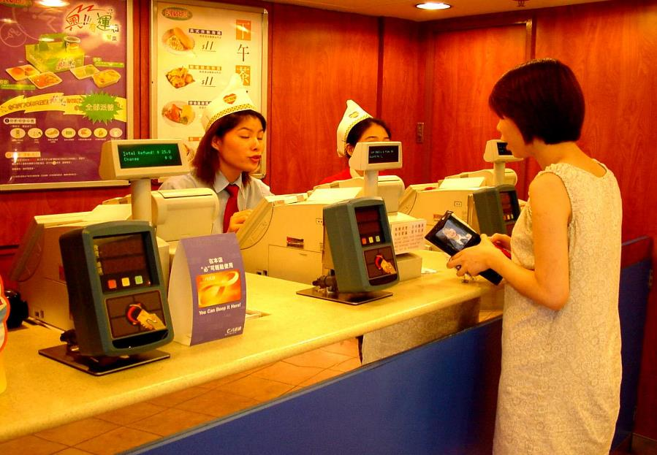
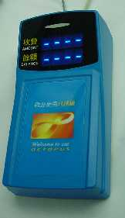
Fast Food

Slide 22
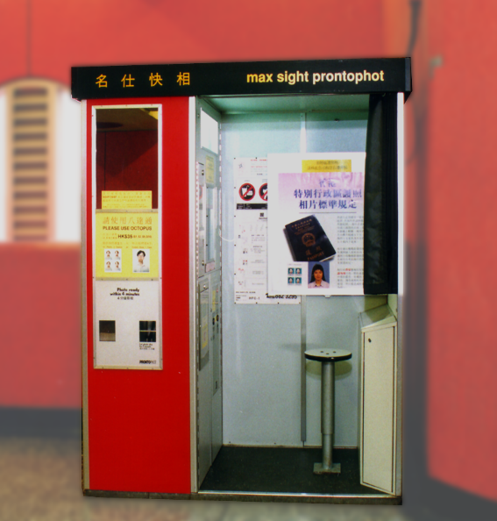
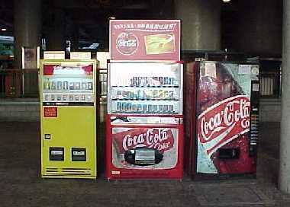
Vending
Vending - Swire CoCa Cola/ Vitasoy
Photos

Slide 23
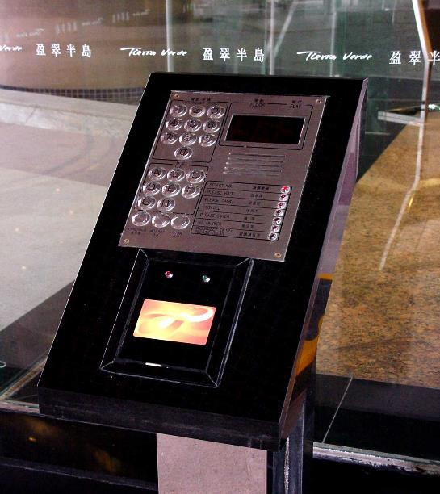
Access Control
Unique identification number for every Octopus card
Access premises
  Tierra Verde
  Waterfront
Controls door
Connected to Office PC for Access List Update

Slide 24
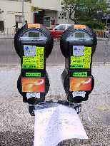
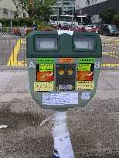
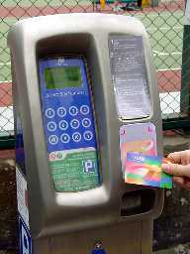
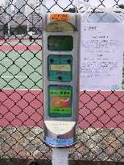
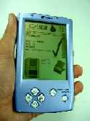
On Street Parking Meters
Integrated into different types of parking meters
Data collected via handheld computer
May go wireless in the future

Slide 25
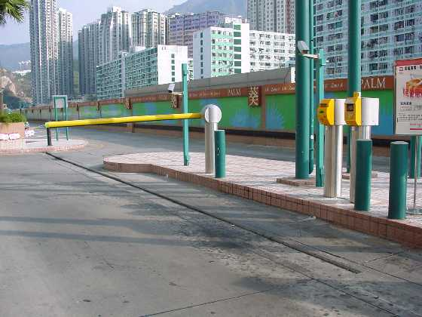
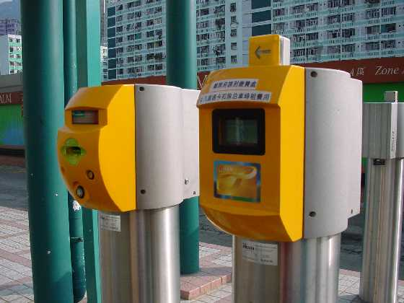
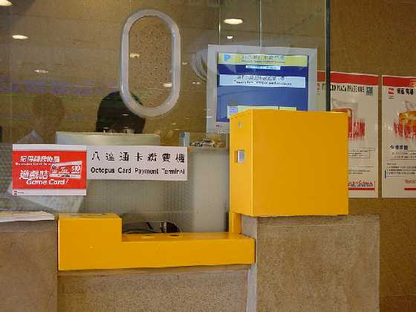
Off Street Parking
Octopus payment at Shroff
Direct entry/exit using Octopus

Slide 26
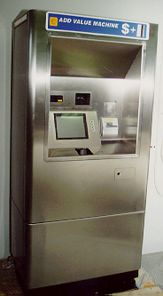
Add Value
Add Value Machines at stations
Customer service outlets
7-Eleven stores
Autopay
  Dah Sing Bank
  Standard Chartered Bank

Slide 27
System Architecture
Four inter-connected layers
    Central Clearing House System (CCHS)
    Service Providers’ Central Computer (SPCC)
    Local Data Processing (LDP)
    Octopus Processor

Slide 28


Fig 1- Octopus System
Sun ULTRASparc Server
Backup
CCHS
Server
Fiber Optic
Frame Relay Network
KCR
LRT
SPCC
KMB
CTB
HYF
MTR
Frame Relay
Sun Workstations
LDP
Octopus Processor
AVM
Gates

Slide 29
Systems
Sun SPARC machines
Unix operating system
TCP/IP network
Frame relay links
Proven technology

Slide 30
Data Consolidation
Creative Star Database
Seq No. Date Time Amt SP RV Last AV Device
100 01/2/99 12:05 -$3.7 MTR $197.5 091234
099 31/1/99 13:15 +$100.0 MTR $201.2 091234
098 28/1/99 19:05 -$3.7 MTR $101.2 094567
097 26/1/99 17:00 -$8.9 KMB $104.9 094567
096 25/1/99 18:20 -$9.9 MTR $113.8 094567
095 24/1/99 17:20 -$8.9 KMB $123.7 094567
094 24/1/99 08:53 -$9.9 MTR $132.6 094567
093 23/1/99 17:00 -$7.5 KMB $142.5 094567
092 23/1/99 08:20 -$9.9 MTR $150.0 094567
091 22/1/99 18:52 -$9.9 MTR $159.9 094567
MTR Database
Seq No. Date Time Amt RV Details AV Dev
100 01/2/99 12:05 -$3.7 197.5 Wanchai->Central 091234
099 31/1/99 13:15 +$100.0 201.2 Kowloon Bay 091234
098 28/1/99 19:05 -$3.7 101.2 Central->Wanchai 094567
096 25/1/99 18:20 -$9.9 113.8 Wanchai->Mongkok 094567
094 24/1/99 08:53 -$9.9 132.6 Mongkok->Wanchai 094567
092 23/1/99 08:20 -$9.9 150.0 Mongkok->Central 094567
091 22/1/99 18:52 -$9.9 159.9 Central->Mongkok 094567
KMB Database
Seq No. Date Time Amt RV Details AV Device
097 26/1/99 17:00 -$8.9 104.9 Route 115 094567
095 24/1/99 17:20 -$8.9 123.7 Route 105 094567
093 23/1/99 17:00 -$7.5 142.5 Route 104 094567

Slide 31
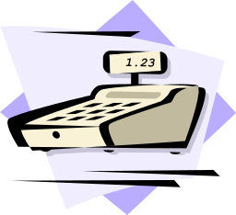

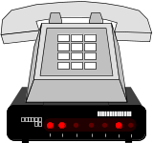
Acquirer Interface
Through SP’s network
or
Different types of Octopus Processor
Central Clearing House System
Acquirer
Service Providers
Reports

Slide 32
Future Plans
All transport applications
High-volume, low-value transaction businesses
Strategic partnerships for development of wider applications
Hybrid Cards
  Octopus + credit/debit card
  Contactless and Contact on same card

Slide 33
Conclusion
Bring convenience to the public
Bring benefits to service providers
Reliable and fast payment
Low cost operations

Slide 34
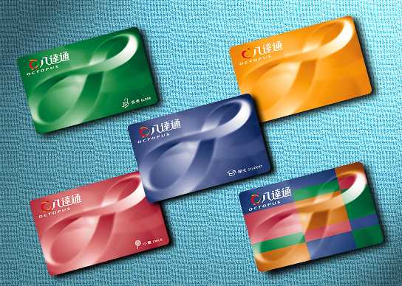
The Octopus – Thank You

